Slide 1

BucketMap Raleigh
Tamilthaaragai Muthukumar
Viralkumar Sanghavi
Haizhou Wu
Nithya Pari
Nupur Mallik

Slide 2
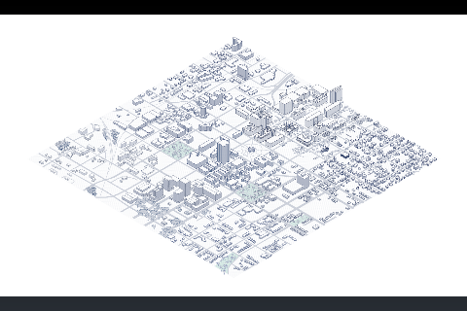
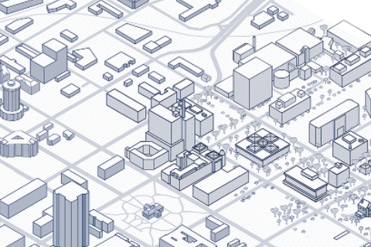
Progress – Zoom in & Zoom out

Slide 3
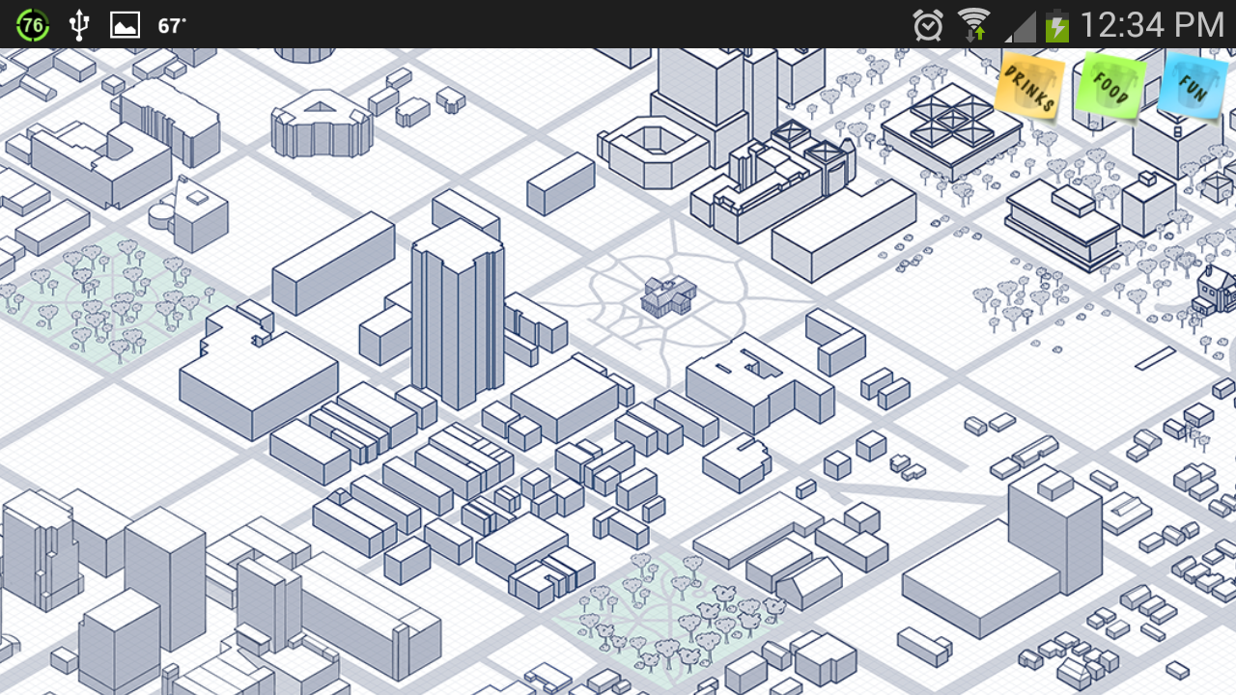
Progress – Filters
Buildings Highlighted based on category selected from button Click -Food, Drinks, Entertainment
Image overlays used to place filter buttons on top of the map image

Slide 4
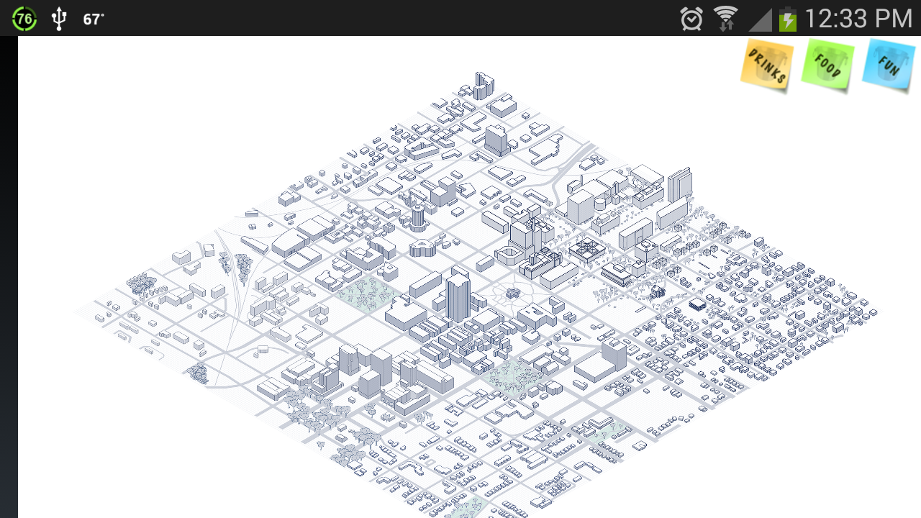

Slide 5
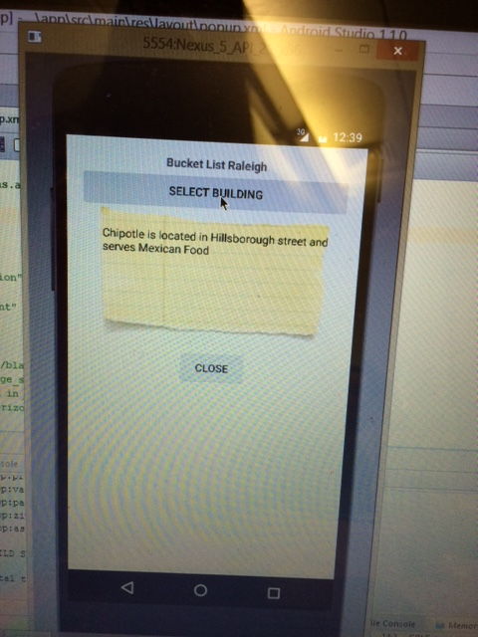
Progress – Sticky Note Pop Up – Building Info
Second popup layout created over the base Main layout
Using android.widget library, we were able to create a pop up frame.
The setOnClickListener() function to listen for a click and then call the popup layout.
The textView of the popup layout is now updated with information about the building.
Integrated the stickynote image behind the text

Slide 6
Progress – Touch Targets
Absolute Pixel Positioning is used
Pixel Targets don’t change even if the image is scaled
onActionDown(), the sticky note pops up with building information

Slide 7
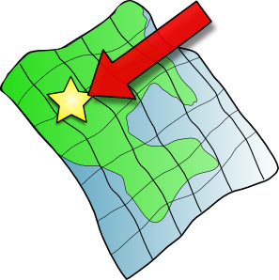
Road Map
Integrating backend with Parse (Server side) where images will be stored
Doodling on Map - Drawing over map Image with color choice made from a color palette
User Profiles to register with the app and use it after authentication
Social Media Integration to share the doodle with friends

